Slide 1
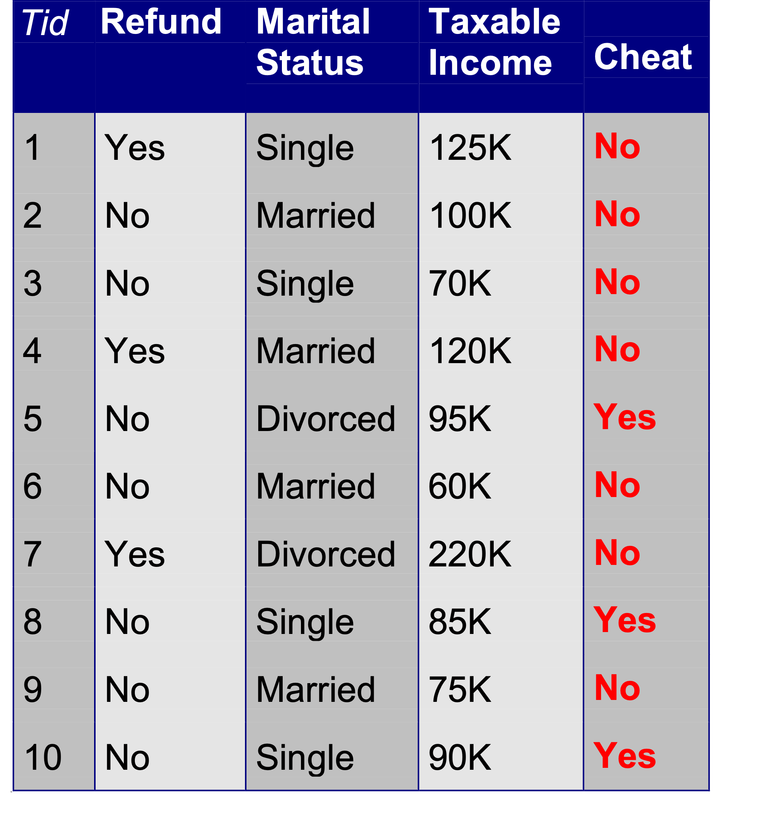
Example of a Decision Tree
categorical
categorical
continuous
class
Splitting Attributes
Refund
Yes
No
NO
MarSt
Single, Divorced
Married
TaxInc
NO
< 80K
> 80K
NO
YES
Model: Decision Tree
Training Data

Slide 2
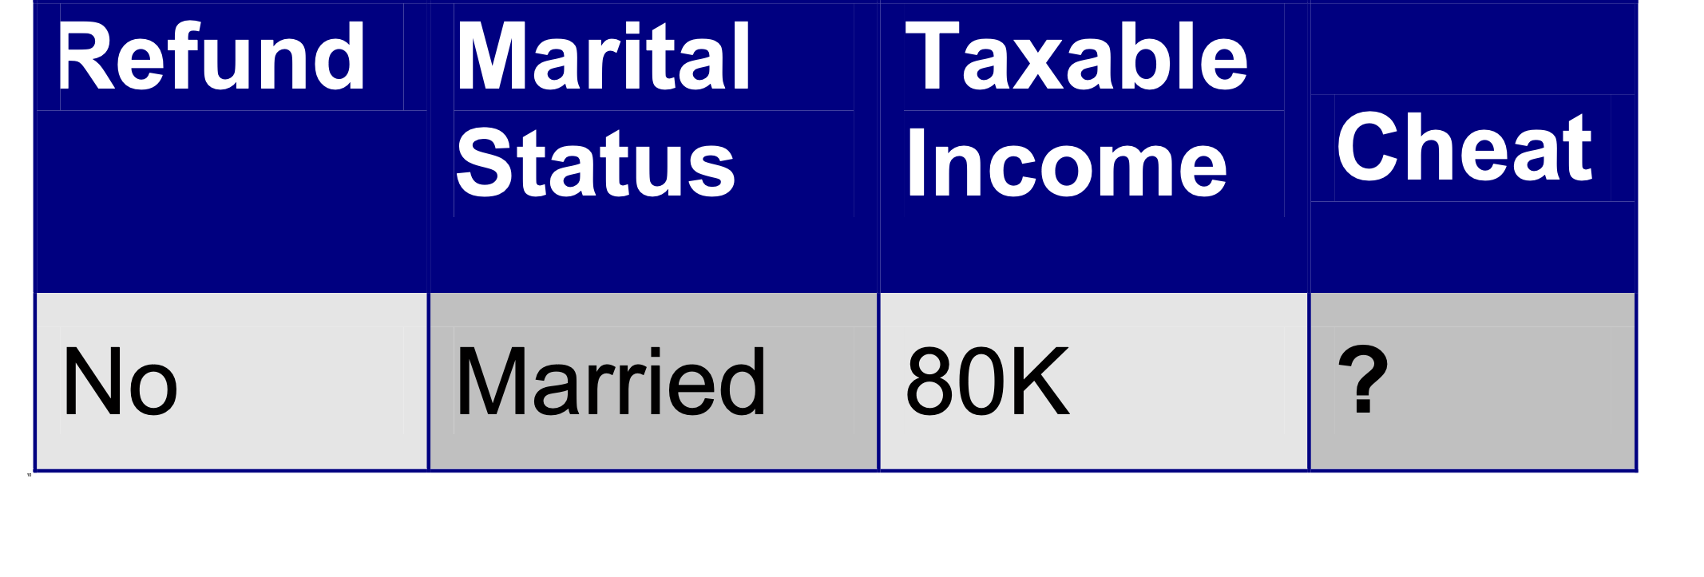
Apply Model to Test Data
Test Data
Start from the root of tree.
Refund
Yes
No
NO
MarSt
Single, Divorced
Married
TaxInc
NO
< 80K
> 80K
NO
YES

Slide 3
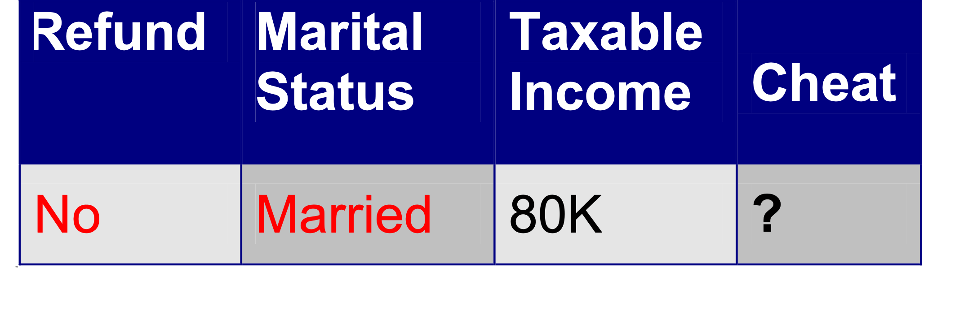
Apply Model to Test Data
Test Data
Refund
Yes
No
NO
MarSt
Single, Divorced
Married
Assign Cheat to “No”
TaxInc
NO
< 80K
> 80K
NO
YES

Slide 4
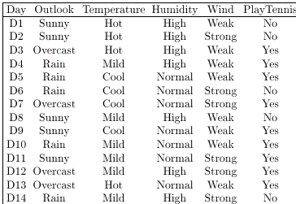
DECISION TREES
Example

Slide 5
DECISION TREES
Outlook
Example
Sunny
Rain
Overcast
Humidity Wind
Yes
High
Normal
Strong
Weak
Yes
Yes
No
No
A Decision Tree for the concept PlayTennis
An unknown observation is classified by testing its attributes and reaching a leaf node

Slide 6
DECISION TREES
Decision Tree Representation
Decision trees represent a disjunction of conjunctions of constraints on the attribute values of instances
Each path from the tree root to a leaf corresponds to a conjunction of attribute tests (one rule for classification)
The tree itself corresponds to a disjunction of these conjunctions (set of rules for classification)

Slide 7
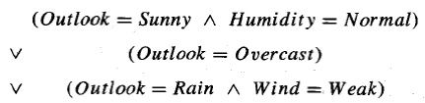
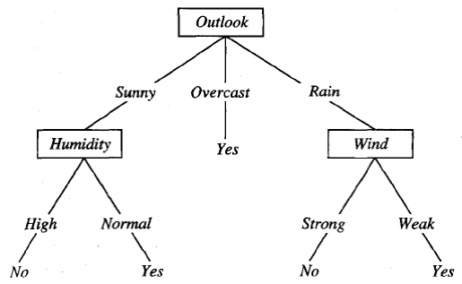
DECISION TREES
Decision Tree Representation

Slide 8
DECISION TREES
Basic Decision Tree Learning Algorithm
Most algorithms for growing decision trees are variants of a basic algorithm
An example of this core algorithm is the ID3 algorithm developed by Quinlan (1986)
It employs a top-down, greedy search through the space of possible decision trees

Slide 9
DECISION TREES
Basic Decision Tree Learning Algorithm
First of all we select the best attribute to be tested at the root of the tree
For making this selection each attribute is evaluated using a statistical test to determine how well it alone classifies the training examples

Slide 10
DECISION TREES
Basic Decision Tree Learning Algorithm
We have
12 observations
4 attributes
Outlook
Temperature
Humidity
Wind
2 classes (Yes, No)
D12
D11
D1
D2
D5
D10
D4
D6
D3
D14
D8
D9
D7
D13

Slide 11
DECISION TREES
Basic Decision Tree Learning Algorithm
Outlook
Sunny
Rain
Overcast
D10
D6
D1
D8
D3
D14
D4
D11
D12
D9
D2
D7
D5
D13

Slide 12
DECISION TREES
Basic Decision Tree Learning Algorithm
The selection process is then repeated using the training examples associated with each descendant node to select the best attribute to test at that point in the tree

Slide 13
DECISION TREES
Outlook
Sunny
Rain
Overcast
D10
D6
D1
D8
D3
D14
D4
D11
D12
D9
D2
D7
D5
D13
What is the
“best” attribute to test at this point? The possible choices are
Temperature, Wind & Humidity

Slide 14
DECISION TREES
Basic Decision Tree Learning Algorithm
This forms a greedy search for an acceptable decision tree, in which the algorithm never backtracks to reconsider earlier choices

Slide 15
DECISION TREES
Which Attribute is the Best Classifier?
The central choice in the ID3 algorithm is selecting which attribute to test at each node in the tree
We would like to select the attribute which is most useful for classifying examples
For this we need a good quantitative measure
For this purpose a statistical property, called information gain is used

Slide 16
DECISION TREES
Which Attribute is the Best Classifier?: Definition of Entropy
In order to define information gain precisely, we begin by defining entropy
Entropy is a measure commonly used in information theory, called.
Entropy characterizes the impurity of an arbitrary collection of examples

Slide 17
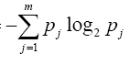
DECISION TREES
Which Attribute is the Best Classifier?: Definition of Entropy
This formula is called Entropy H
H(X) =
High Entropy means that the examples have more equal probability of occurrence (and therefore not easily predictable)
Low Entropy means easy predictability

Slide 18
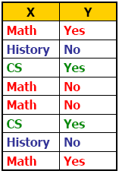
DECISION TREES
Which Attribute is the Best Classifier?: Information Gain
Suppose we are trying to predict output Y (Like Film Gladiator) & we have input X (College Major = v)
Major
Math
CS
History

Slide 19
Calculations - (Info Gain of Att X)
InfoGain(X) = Ent(class) - Ent(class | X)
Ent(class) = -[4/8*log2 4/8 + 4/8*log2 4/8 ]
= - [0.5 (log10 0.5/log10 2) + 0.5 (log10 0.5/log10 2)]
= 1
Ent(class | X) = 4/8 Ent(class | X=Maths) +
2/8 Ent(class | X=History) +
2/8 Ent(class | X=CS)
Ent(class | X = Math) = -[2/4log2 2/4 + 2/4log2 2/4]
= - [0.5 (log10 0.5/log10 2) + 0.5 (log10 0.5/log10 2)]
= 1
Ent(class | X = Hist) = -[2/2 log2 2/2] = 0
Ent(class | X = CS) = -[2/2 log2 2/2] = 0
Ent(class | X) = 4/8 * 1 + 2/8 * 0 + 2/8 * 0 = 0.5
InfoGain(X) = Ent(class) - Ent(class | X) = 1 - 0.5 = 0.5

Slide 20
DECISION TREES
Which Attribute is the Best Classifier?: Information gain
We have H(X) = 1.5 H(Y) = 1.0
Conditional Entropy H(Y | X = v)
The Entropy of Y among only those records in which X = v
Major
Math
CS
History

Slide 21
DECISION TREES
Which Attribute is the Best Classifier?: Information Gain
Conditional Entropy of Y
H(Y | X = Math) = 1.0
H(Y | X = History) = 0
H(Y | X = CS) = 0
Major
Math
CS
History

Slide 22
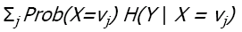
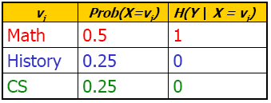
DECISION TREES
Which Attribute is the Best Classifier?: Information Gain
Average Conditional Entropy of Y
H(Y | X) =
Major
Math
CS
History

Slide 23
DECISION TREES
Which Attribute is the Best Classifier?: Information Gain
Information Gain is the expected reduction in entropy caused by partitioning the examples according to an attribute’s value
Info Gain (Y | X) = H(Y) – H(Y | X) = 1.0 – 0.5 = 0.5
For transmitting Y, how much bits would be saved if both side of the line knew X
In general, we write Gain (S, A)
Where S is the collection of examples & A is an attribute

Slide 24
DECISION TREES
Which Attribute is the Best Classifier?: Information Gain
Let’s investigate the attribute Wind

Slide 25
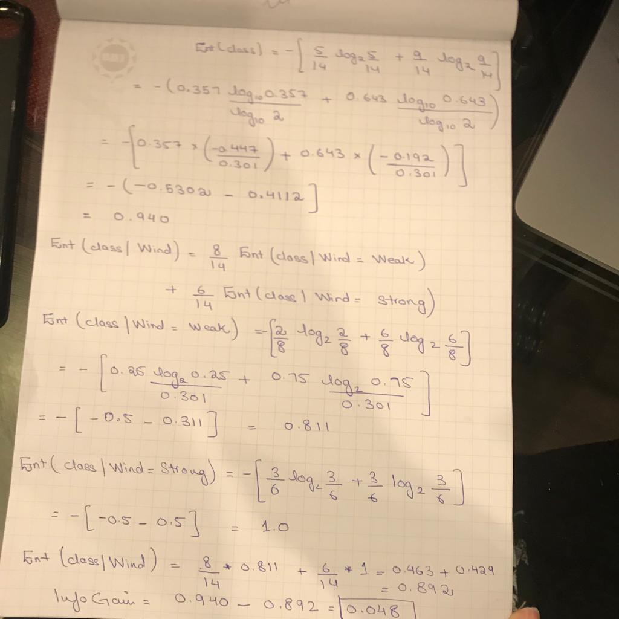
Calculations for Info Gain of Wind

Slide 26
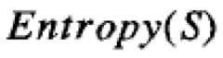
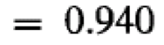
DECISION TREES
Which Attribute is the Best Classifier?: Information Gain
The collection of examples has 9 positive values and 5 negative ones
Eight (6 positive and 2 negative ones) of these examples have the attribute value Wind = Weak
Six (3 positive and 3 negative ones) of these examples have the attribute value Wind = Strong

Slide 27
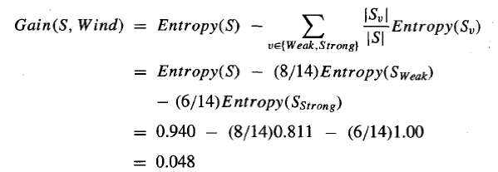
DECISION TREES
Which Attribute is the Best Classifier?: Information Gain
The information gain obtained by separating the examples according to the attribute Wind is calculated as:

Slide 28
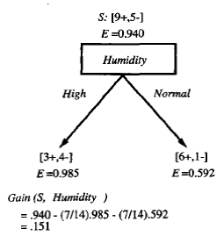
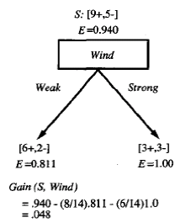
DECISION TREES
Which Attribute is the Best Classifier?: Information Gain
We calculate the Info Gain for each attribute and select the attribute having the highest Info Gain

Slide 29
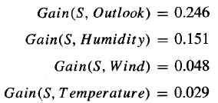
DECISION TREES
Example
Which attribute should be selected as the first test?
“Outlook” provides the most information

Slide 30
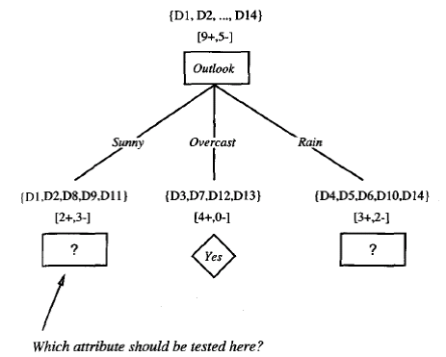
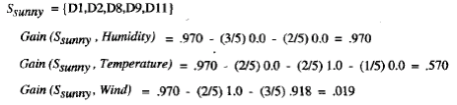
DECISION TREES

Slide 31
DECISION TREES
Example
The process of selecting a new attribute is now repeated for each (non-terminal) descendant node, this time using only training examples associated with that node
Attributes that have been incorporated higher in the tree are excluded, so that any given attribute can appear at most once along any path through the tree

Slide 32
DECISION TREES
Example
This process continues for each new leaf node until either:
Every attribute has already been included along this path through the tree
The training examples associated with a leaf node have zero entropy

Slide 33
DECISION TREES
Example

Slide 34
DECISION TREES
From Decision Trees to Rules
Next Step: Make rules from the decision tree
After making the identification tree, we trace each path from the root node to leaf node, recording the test outcomes as antecedents and the leaf node classification as the consequent
For our example we have:
If the Outlook is Sunny and the Humidity is High then No
If the Outlook is Sunny and the Humidity is Normal then Yes
...

Slide 35
Two Types of Decision Tree
Classification
Classification trees are applied on data when the outcome is discrete in nature or is categorical such as presence or absence of students in a class, a person died or survived, approval of loan
Regression
Regression trees are used when the outcome of the data is continuous in nature such as prices, age of a person, length of stay in a hotel, etc.

Slide 36
Decision Tree Algorithms
ID3, C4.5, CART and ChAD

Slide 37
ID3 – Iterative Dichotomiser 3
ID3 generates a tree by considering the whole set S as the root node.
It then iterates on every attribute and splits the data into fragments known as subsets to calculate the entropy or the information gain of that attribute.
After splitting, the algorithm recourses on every subset by taking those attributes which were not taken before into the iterated ones.
It is not an ideal algorithm as it generally overfits the data and on continuous variables, splitting the data can be time consuming.

Slide 38
C4.5
It is quite advanced compared to ID3.
The splitting is done based on the normalized information gain and the feature having the highest information gain makes the decision.
Unlike ID3, it can handle both continuous and discrete attributes very efficiently and after building a tree
It undergoes pruning by removing all the branches having low importance

Slide 39
CART - Classification and Regression Trees
CART can perform both classification and regression tasks and they create decision points by considering Gini index unlike ID3 or C4.5 which uses information gain for split.
For splitting, CART follows a greedy algorithm which aims only to reduce the cost function.
For classification, cost function such as Gini index is used to indicate the purity of the leaf nodes.
For regression, sum squared error is chosen by the algorithm as the cost function to find out the best prediction.
Note: Regression is a data mining function that predicts a number. Profit, sales, mortgage rates, house values, square footage, temperature, or distance could all be predicted using regression techniques.

Slide 40
CHAID
CHAID or Chi-square Automatic Interaction Detector is a process which can deal with any type of variables be it nominal, ordinal or continuous.
In regression tree, it uses F-test and in classification trees, it uses the Chi-Square test.
In this analysis, continuous predictors are separated into equal number of observations until an outcome is achieved.
It is very less used and adopted in real world problems compared to other algorithms.

Slide 41
Splitting Criterias
Entropy, Information gain, Gini Index, Chi-Square and Reduction in Variance

Slide 42
Splitting Criteria
Entropy
Information Gain
Gini Index
Chi - square
Reduction in variance

Slide 43
Entropy
It is defined as a measure of impurity present in the data.
The entropy is almost zero when the sample attains homogeneity but is one when it is equally divided.
Entropy with the lowest value makes a model better in terms of prediction as it segregates the classes better.

Slide 44
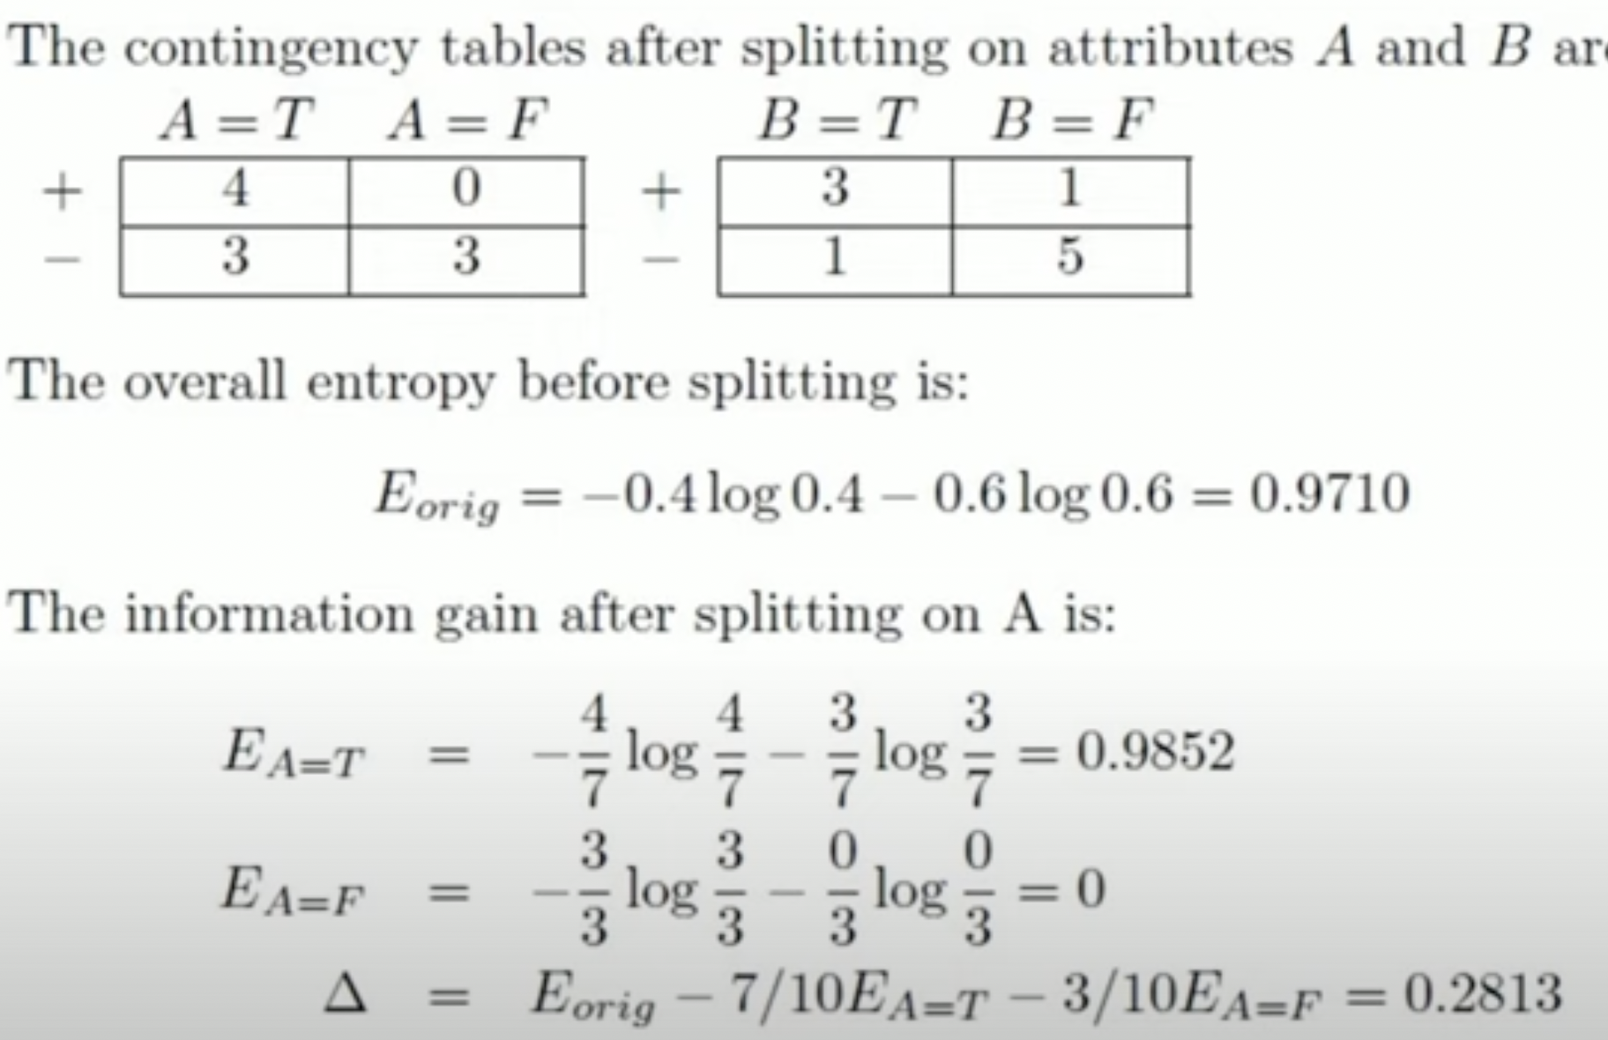
Example - Entropy
A | B | Class
T | F | +
T | T | +
T | T | +
T | F | -
T | T | +
F | F | _
F | F | _
F | F | _
T | T | _
T | F | _

Slide 45
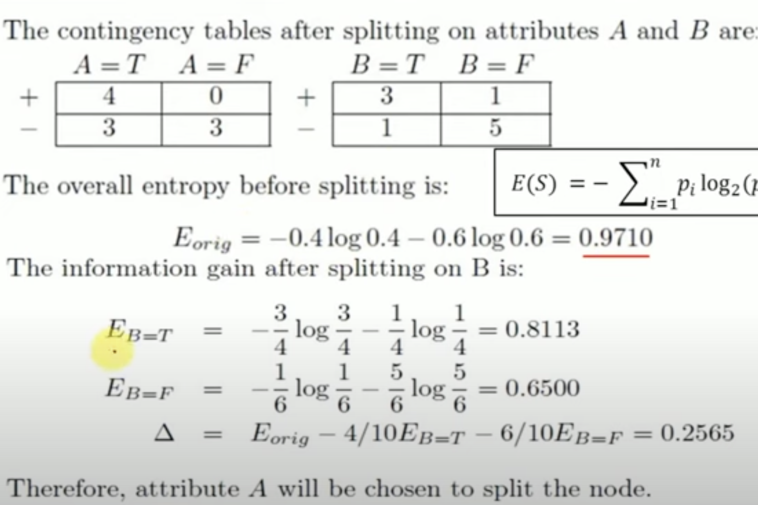
Example - Entropy
A | B | Class
T | F | +
T | T | +
T | T | +
T | F | -
T | T | +
F | F | _
F | F | _
F | F | _
T | T | _
T | F | _

Slide 46
Information Gain
It is a measure used to generalize the impurity which is entropy in a dataset.
Higher the information gain, lower is the entropy.
An event having low probabilities to occur has lower entropy and high information whereas an event having high probabilities has higher entropy and low information. It is calculated as
Information Gain = Entropy of Parent – sum (weighted % * Entropy of Child)

Slide 47
Example – Information Gain
A | B | Class
T | F | +
T | T | +
T | T | +
T | F | -
T | T | +
F | F | _
F | F | _
F | F | _
T | T | _
T | F | _

Slide 48
Example – Information Gain
A | B | Class
T | F | +
T | T | +
T | T | +
T | F | -
T | T | +
F | F | _
F | F | _
F | F | _
T | T | _
T | F | _

Slide 49
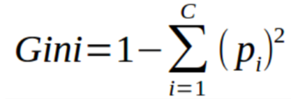
Gini Index
It is a measure of misclassification and is used when the data contain multi class labels.
Gini is similar to entropy but it calculates much quicker than entropy.
Algorithms like CART (Classification and Regression Tree) use Gini as an impurity parameter.

Slide 50
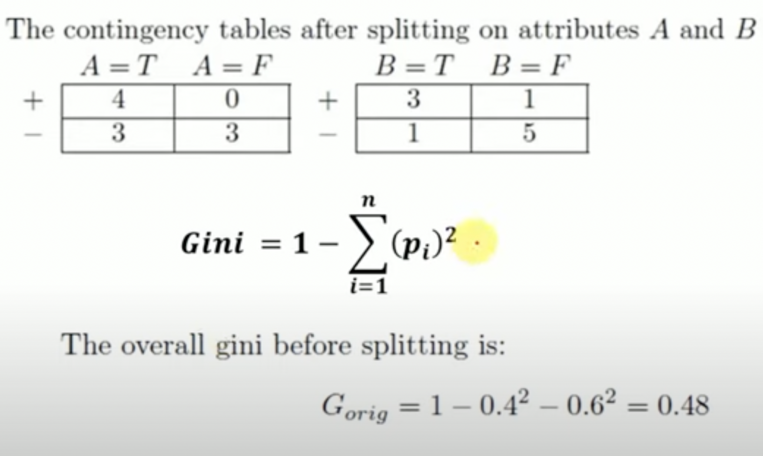
Example – Gini Index
A | B | Class
T | F | +
T | T | +
T | T | +
T | F | -
T | T | +
F | F | _
F | F | _
F | F | _
T | T | _
T | F | _

Slide 51
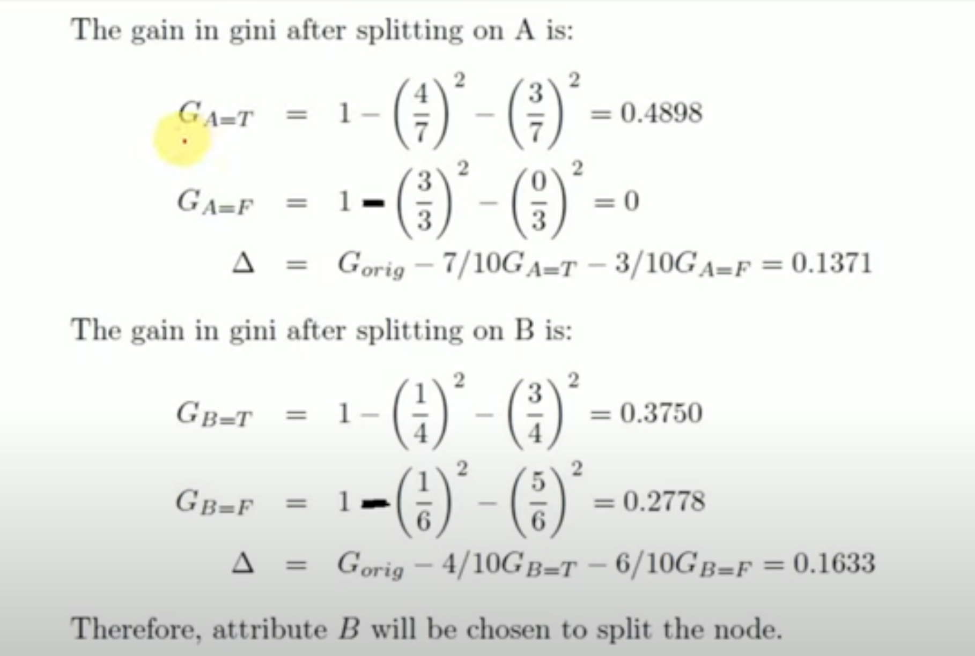
Example – Gini Index
A | B | Class
T | F | +
T | T | +
T | T | +
T | F | -
T | T | +
F | F | _
F | F | _
F | F | _
T | T | _
T | F | _

Slide 52
Example – Gini Index
A | B | Class
T | F | +
T | T | +
T | T | +
T | F | -
T | T | +
F | F | _
F | F | _
F | F | _
T | T | _
T | F | _

Slide 53
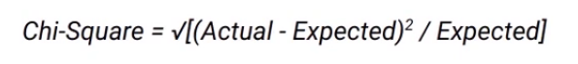
Chi-Square
Let’s now understand the steps to calculate chi-square for a split-
First, we need to calculate the expected values for each class.
Then we calculate the chi-square for individual nodes using
this formula that we’ve seen before-

Slide 54
$χ^{2}$Correlation for Nominal Data
Suppose that a group of 1500 people was surveyed.
The gender of each person was noted. Each person was polled as to whether his or her preferred type of reading material was ﬁction or nonﬁction.
Thus, we have two attributes, gender and preferred reading.
The observed frequency (or count) of each possible joint event is summarized in the contingency table

Slide 55
$χ^{2}$Correlation for Nominal Data
 | male | female | Total
fiction
non-fiction
Total

Slide 56

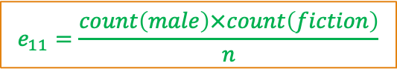
$χ^{2}$Correlation for Nominal Data
 | male | female | Total
fiction | 250 | 200 | 450
non-fiction | 50 | 1000 | 1050
Total | 300 | 1200 | 1500
1- Find expected values for this contingency Table
$$e_{11}=\frac{count\left(male\right)×count\left(fiction\right)}{n}$$
$$e_{11}=\frac{300×450}{1500}=90$$
 | male | female
fiction | 90
non-fiction

Slide 57
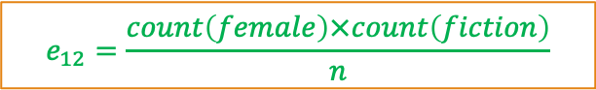

$χ^{2}$Correlation for Nominal Data
 | male | female | Total
fiction | 250 | 200 | 450
non-fiction | 50 | 1000 | 1050
Total | 300 | 1200 | 1500
1- Find expected values for this contingency Table
$$e_{12}=\frac{count\left(female\right)×count\left(fiction\right)}{n}$$
$$e_{12}=\frac{1200×450}{1500}=360$$
 | male | female
fiction | 90 | 360
non-fiction

Slide 58
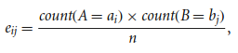
$χ^{2}$Correlation for Nominal Data
 | male | female | Total
fiction | 250 | 200 | 450
non-fiction | 50 | 1000 | 1050
Total | 300 | 1200 | 1500
1- Find expected values for this contingency Table
$$e_{12}=\frac{count\left(female\right)×count\left(fiction\right)}{n}$$
$$e_{12}=\frac{1200×450}{1500}=360$$
 | male | female
fiction | 90 | 360
non-fiction | 210 | 840

Slide 59
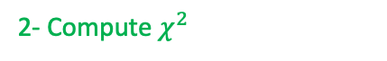
$χ^{2}$Correlation for Nominal Data
 | male | female | Total
fiction | 250 | 200 | 450
non-fiction | 50 | 1000 | 1050
Total | 300 | 1200 | 1500
 | male | female
fiction | 90 | 360
non-fiction | 210 | 840
2- Compute $χ^{2}$
$$χ^{2}=\frac{{\left(250−90\right)}^{2}}{90}+\frac{{\left(50−210\right)}^{2}}{210}+\frac{{\left(200−360\right)}^{2}}{360}+\frac{{\left(1000−840\right)}^{2}}{840}$$
$$χ^{2}=284.44+121.90+71.11+30.48=507.93$$

Slide 60
$χ^{2}$Correlation for Nominal Data
 | male | female | Total
fiction | 250 (90) | 200 (360) | 450
non-fiction | 50 (210) | 1000 (840) | 1050
Total | 300 | 1200 | 1500
2- Compute $χ^{2}$
$$χ^{2}=\frac{{\left(250−90\right)}^{2}}{90}+\frac{{\left(50−210\right)}^{2}}{210}+\frac{{\left(200−360\right)}^{2}}{360}+\frac{{\left(1000−840\right)}^{2}}{840}$$
$$χ^{2}=284.44+121.90+71.11+30.48=507.93$$

Slide 61
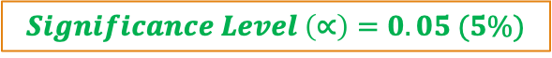

$χ^{2}$Analysis
The larger the $χ^{2}$ value, the more likely the variables are related
The cells that contribute the most to the $χ^{2}$ value are those whose actual count is very different from the expected count
Remember: Correlation does not imply causality
Null Hypothesis: There is no relation between “gender” and “preferred reading ”
Alternate Hypothesis: There is significant relation between “gender” and “preferred reading ”
$$χ^{2}=507.93$$
$$Significance Level \left(∝\right)=0.05 (5\%)$$
$$Degree of Freedom=\left(columns−1\right)×\left(rows−1\right)=(2−1)×(2−1)=1$$

Slide 62
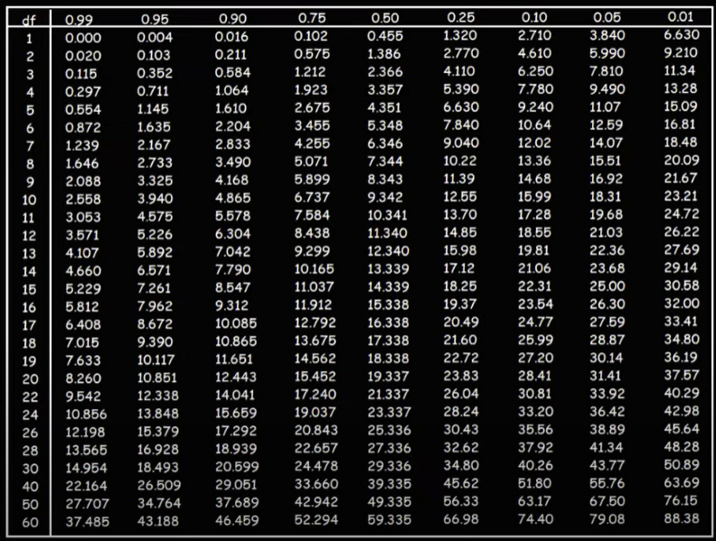
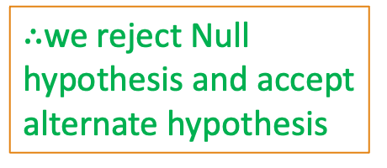

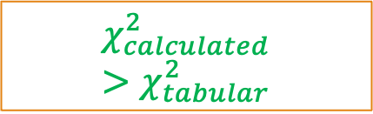
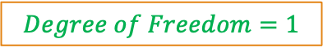
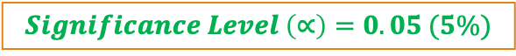
$χ^{2}$Analysis
$$Significance Level \left(∝\right)=0.05 (5\%)$$
$$χ^{2}=507.93$$
$$Degree of Freedom=1$$
$$χ_{calculated}^{2}>χ_{tabular}^{2}$$
$∴$we reject Null hypothesis and accept alternate hypothesis

Slide 63
$χ^{2}$Analysis
Since our computed value is above the tabular value, we can reject the hypothesis that “gender” and “preferred reading ” are independent and conclude that the two attributes are (strongly) correlated for the given group of people.
Significance level can be changed but normally it is 5%

Slide 64
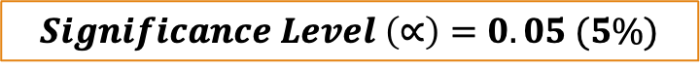
Chi-Square ${(χ}^{2})$: Example 2
Qualification/Marital Status | Middle School | High School | BS | MS | PhD | Total
Never Married | 18 | 36 | 21 | 9 | 6 | 90
Married | 12 | 36 | 45 | 36 | 21 | 150
Divorced | 6 | 9 | 9 | 3 | 3 | 30
Widowed | 3 | 9 | 9 | 6 | 3 | 30
Total | 39 | 90 | 84 | 54 | 33 | 300
Observed Values
Null Hypothesis: There is no relation between “marital status” and “qualification”
Alternate Hypothesis: There is significant relation between “marital status” and “qualification”
$$Significance Level \left(∝\right)=0.05 (5\%)$$
Credit: Vectors Academy

Slide 65
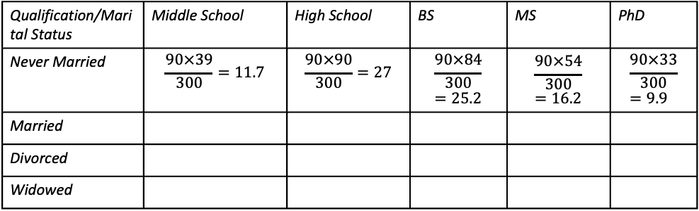
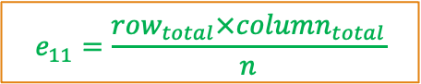
Chi-Square ${(χ}^{2})$: Example 2
$$e_{11}=\frac{row_{total}×column_{total}}{n}$$
Qualification/Marital Status | Middle School | High School | BS | MS | PhD | Total
Never Married | 18 | 36 | 21 | 9 | 6 | 90
Married | 12 | 36 | 45 | 36 | 21 | 150
Divorced | 6 | 9 | 9 | 3 | 3 | 30
Widowed | 3 | 9 | 9 | 6 | 3 | 30
Total | 39 | 90 | 84 | 54 | 33 | 300
Observed Values
Qualification/Marital Status | Middle School | High School | BS | MS | PhD
Never Married | $$\frac{90×39}{300}=11.7$$ | $$\frac{90×90}{300}=27$$ | $$\frac{90×84}{300}=25.2$$ | $$\frac{90×54}{300}=16.2$$ | $$\frac{90×33}{300}=9.9$$
Married
Divorced
Widowed
Expected Values
Credit: Vectors Academy

Slide 66
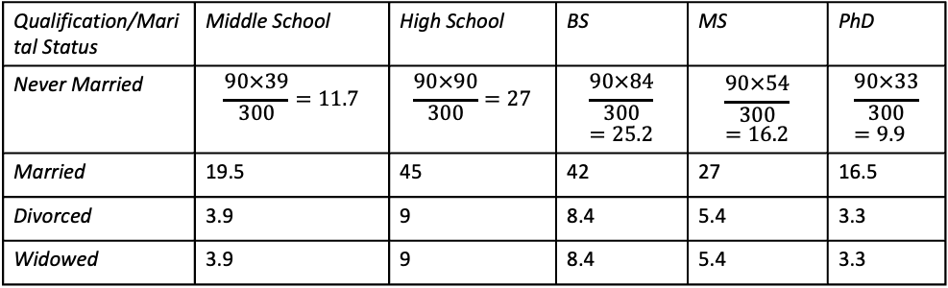
Chi-Square ${(χ}^{2})$: Example 2
$$e_{11}=\frac{row_{total}×column_{total}}{n}$$
Qualification/Marital Status | Middle School | High School | BS | MS | PhD | Total
Never Married | 18 | 36 | 21 | 9 | 6 | 90
Married | 12 | 36 | 45 | 36 | 21 | 150
Divorced | 6 | 9 | 9 | 3 | 3 | 30
Widowed | 3 | 9 | 9 | 6 | 3 | 30
Total | 39 | 90 | 84 | 54 | 33 | 300
Observed Values
Qualification/Marital Status | Middle School | High School | BS | MS | PhD
Never Married | $$\frac{90×39}{300}=11.7$$ | $$\frac{90×90}{300}=27$$ | $$\frac{90×84}{300}=25.2$$ | $$\frac{90×54}{300}=16.2$$ | $$\frac{90×33}{300}=9.9$$
Married | 19.5 | 45 | 42 | 27 | 16.5
Divorced | 3.9 | 9 | 8.4 | 5.4 | 3.3
Widowed | 3.9 | 9 | 8.4 | 5.4 | 3.3
Expected Values
Credit: Vectors Academy

Slide 67
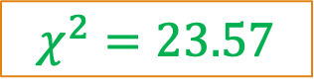
Chi-Square ${(χ}^{2})$: Example 2
$$e_{11}=\frac{row_{total}×column_{total}}{n}$$
Qualification/Marital Status | Middle School | High School | BS | MS | PhD | Total
Never Married | 18 (11.7) | 36 (27) | 21 (25.2) | 9 (16.2) | 6 (9.9) | 90
Married | 12 (19.5) | 36 (45) | 45 (42) | 36 (27) | 21 (16.5) | 150
Divorced | 6 (3.9) | 9 (9) | 9 (8.4) | 3 (5.4) | 3 (3.3) | 30
Widowed | 3 (3.9) | 9 (9) | 9 (8.4) | 6 (5.4) | 3 (3.3) | 30
Total | 39 | 90 | 84 | 54 | 33 | 300
Observed Values
(Expected Values)
$$χ^{2}=23.57$$
$$Degree of Freedom=\left(columns−1\right)×(rows−1)$$
$$Degree of Freedom=\left(5−1\right)×\left(4−1\right)=4×3=12$$
Credit: Vectors Academy

Slide 68
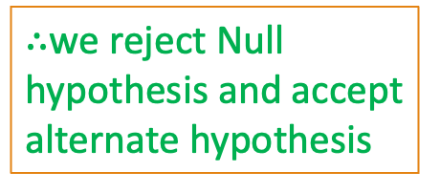
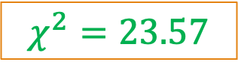
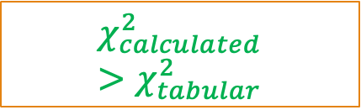

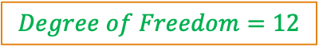
Chi-Square ${(χ}^{2})$: Example 2
$$χ^{2}=23.57$$
$$Degree of Freedom=12$$
$$Significance Level \left(∝\right)=0.05 (5\%)$$
$$χ_{calculated}^{2}>χ_{tabular}^{2}$$
$∴$we reject Null hypothesis and accept alternate hypothesis
Credit: Vectors Academy

Slide 69
Reduction in Variance
Reduction in variance is used when the decision tree works for regression and the output is continuous is nature. The algorithm basically splits the population by using the variance formula.
The criteria of splitting are selected only when the variance is reduced to minimum. The variance is calculated by the basic formula
Watch: https://www.youtube.com/watch?v=i5wGWV5H7oM&t=80s

